Slide 1
Tech Week 2021:
Analytics with Netflix Data and Intro to Algorithms
By Jolene | Hui Xin

Slide 2
Pre-Event Preparations
Code Editor/IDE
Pycharm
VS Code
Python Libraries
Pip install pandas
Pip install matplotlib
Rapid API account
Workshop Materials:
https://github.com/nyp-lit/techweek2021
Notes:
Send into the chat:
here’s the link to all workshop materials: https://github.com/nyp-lit/techweek2021

Slide 3

Timeline
1
2-3.15pm Analysing Netflix Data
3.15-3.25 Break
3.25 - 4.40pm Introduction to Algorithms
4.40-5pm Kahoot and Recap
Event Feedback Form

Slide 4
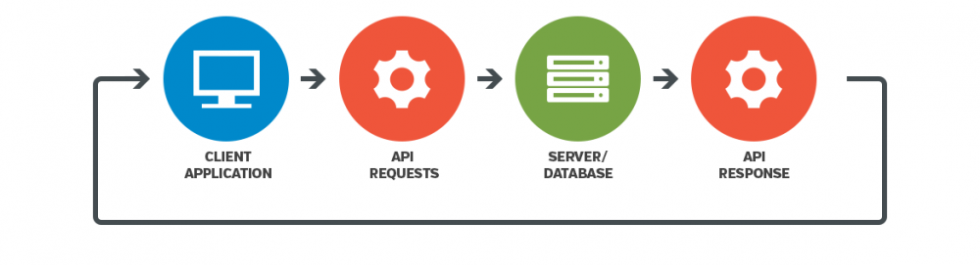
What’s an API?
Notes:
API stands for Application programming interface.
What it does is that it transmits data between software.
Alloc client side applications to communicate with the server/database

Slide 5
What API are we using?
A man's best friend...
Mmm, can I fit in?...
Did you know that dogs can smell your feelings?
Dogs can pick up on subtle changes in your scent, which can help him figure out how you are feeling, such as by smelling your perspiration when you become nervous or fearful.
Did you know that a cat uses its whiskers as feelers to determine if a space is too small to squeeze through?
Also, cats love to sleep. A fifteen-year-old cat has probably spent ten years of its life sleeping.
For our needs, we will be using the IMDB API to get the genres of each movie
https://rapidapi.com/apidojo/api/imdb8

Slide 6
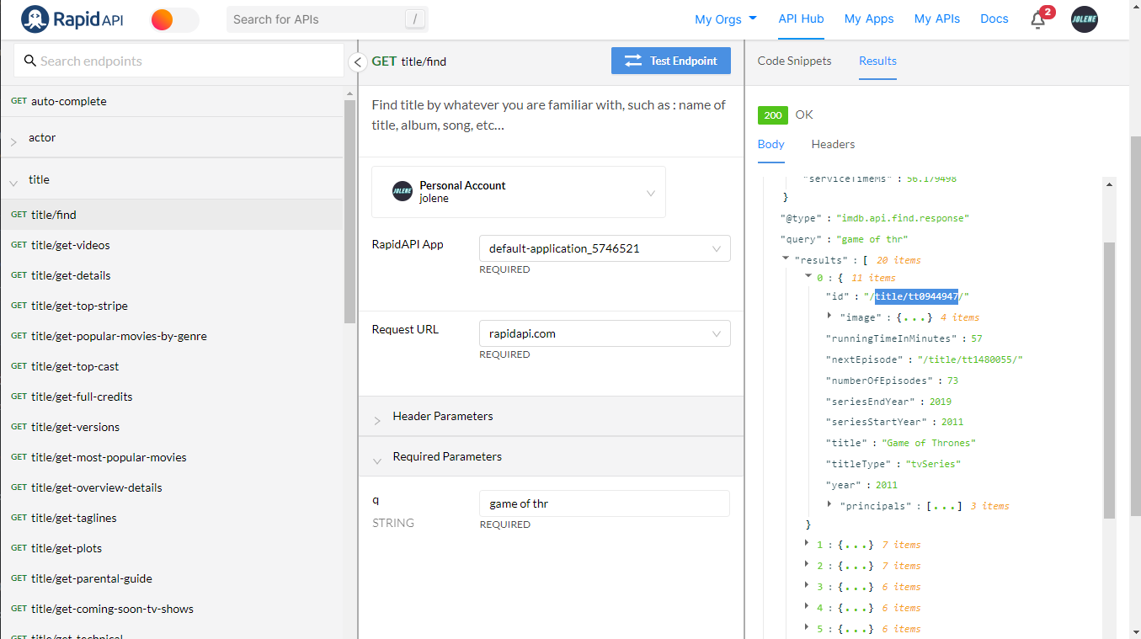
First API call
A man's best friend...
Mmm, can I fit in?...
Did you know that dogs can smell your feelings?
Dogs can pick up on subtle changes in your scent, which can help him figure out how you are feeling, such as by smelling your perspiration when you become nervous or fearful.
Did you know that a cat uses its whiskers as feelers to determine if a space is too small to squeeze through?
Also, cats love to sleep. A fifteen-year-old cat has probably spent ten years of its life sleeping.

Slide 7
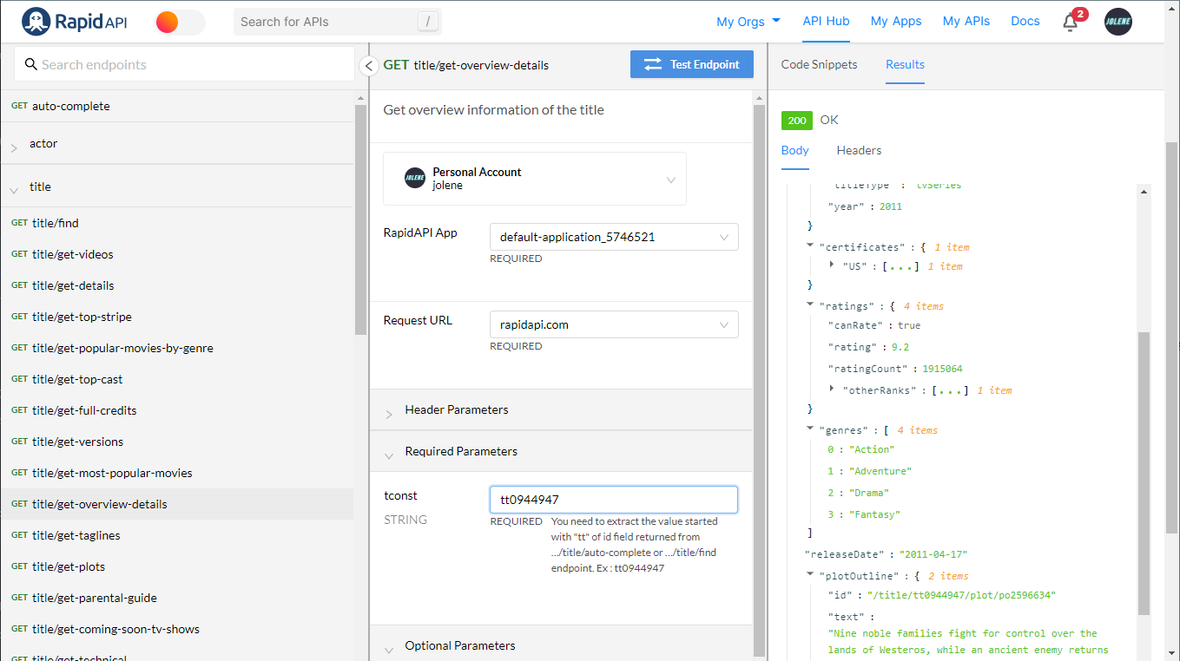
Second API call
A man's best friend...
Mmm, can I fit in?...
Did you know that dogs can smell your feelings?
Dogs can pick up on subtle changes in your scent, which can help him figure out how you are feeling, such as by smelling your perspiration when you become nervous or fearful.
Did you know that a cat uses its whiskers as feelers to determine if a space is too small to squeeze through?
Also, cats love to sleep. A fifteen-year-old cat has probably spent ten years of its life sleeping.

Slide 8
Thank you!
Do you have any questions?
Hop over to the get-support voice channel! We will be there till the end of the event, or feel free to drop us a message in get-support text channel
@nyp_lit on Instagram
nyplit@gmail.com
https://nyp-lit.github.io/
Notes:
flatten() is an example of the recursion algorithm, now let’s move on to intro to algorithms…

